Slide 1
Automotive market in the US
GROUP 2
Cesar Huitron, Lake Pak, Yongsun Cho, Shreeya Prem Jain

Slide 2
Contents
1. Overview
2. Hypothesis Ⅰ, Ⅱ, Ⅲ
3. In The US MARKET
4. New Market Selection
5. New Market Strategies
6. Step 1, 2, 3

Slide 3
OVERVIEW
Based on the information about cars sold in the U.S. from 2014 to 2017,
Through the analysis of three major automobile sales companies,
we intend to establish a strategy to enter a new country.
The relevant information includes car sales, profit margins(%),
each state & city sales, and so on.
It will be approached by testing several hypotheses.

Slide 4
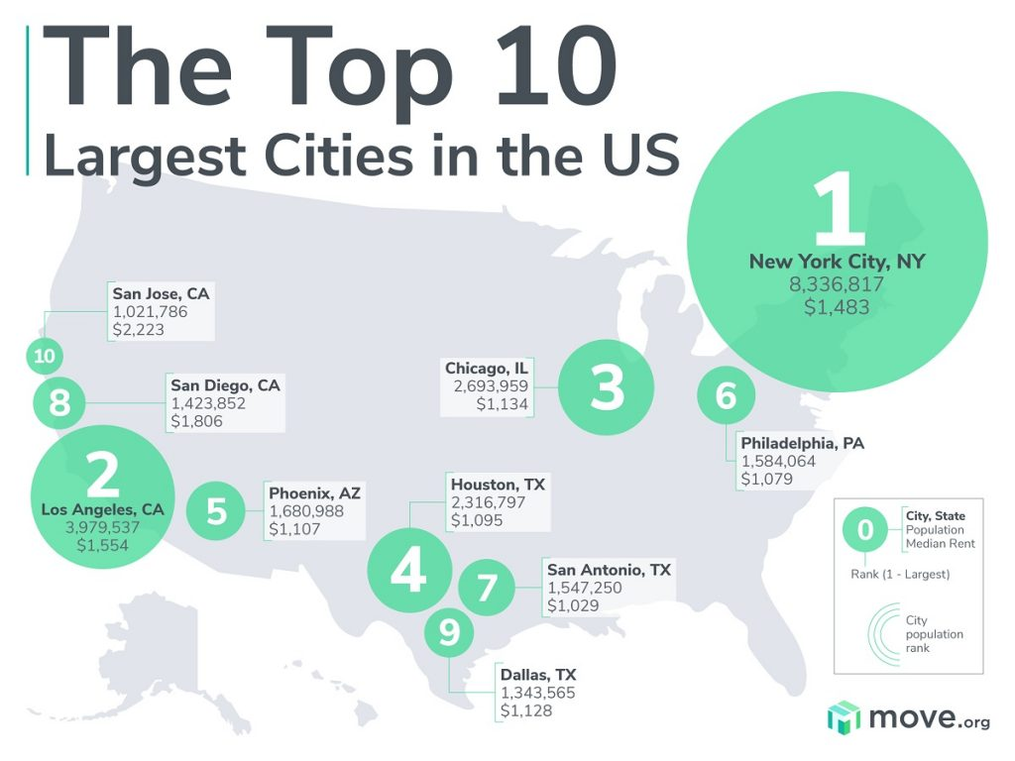
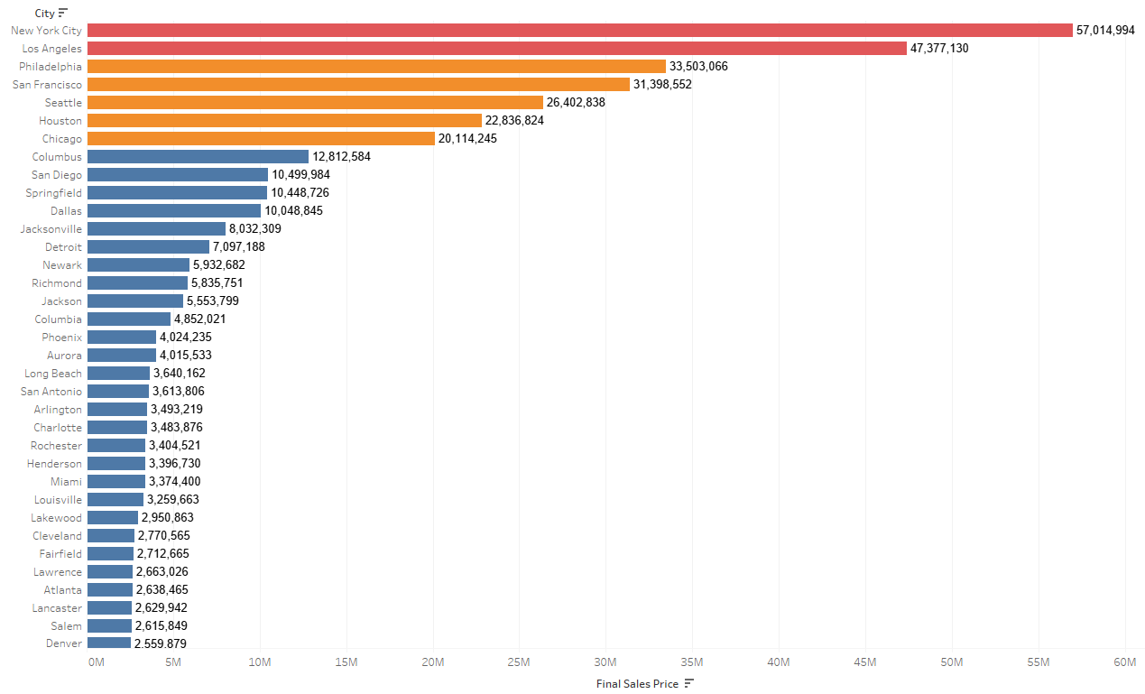
HYPOTHESIS Ⅰ - Larger cities have more sales than smaller
Sales is related with the population
The more populated cities, the more cars are sold
move , 2022 <https://www.move.org/largest-cities-in-the-us/>

Slide 5
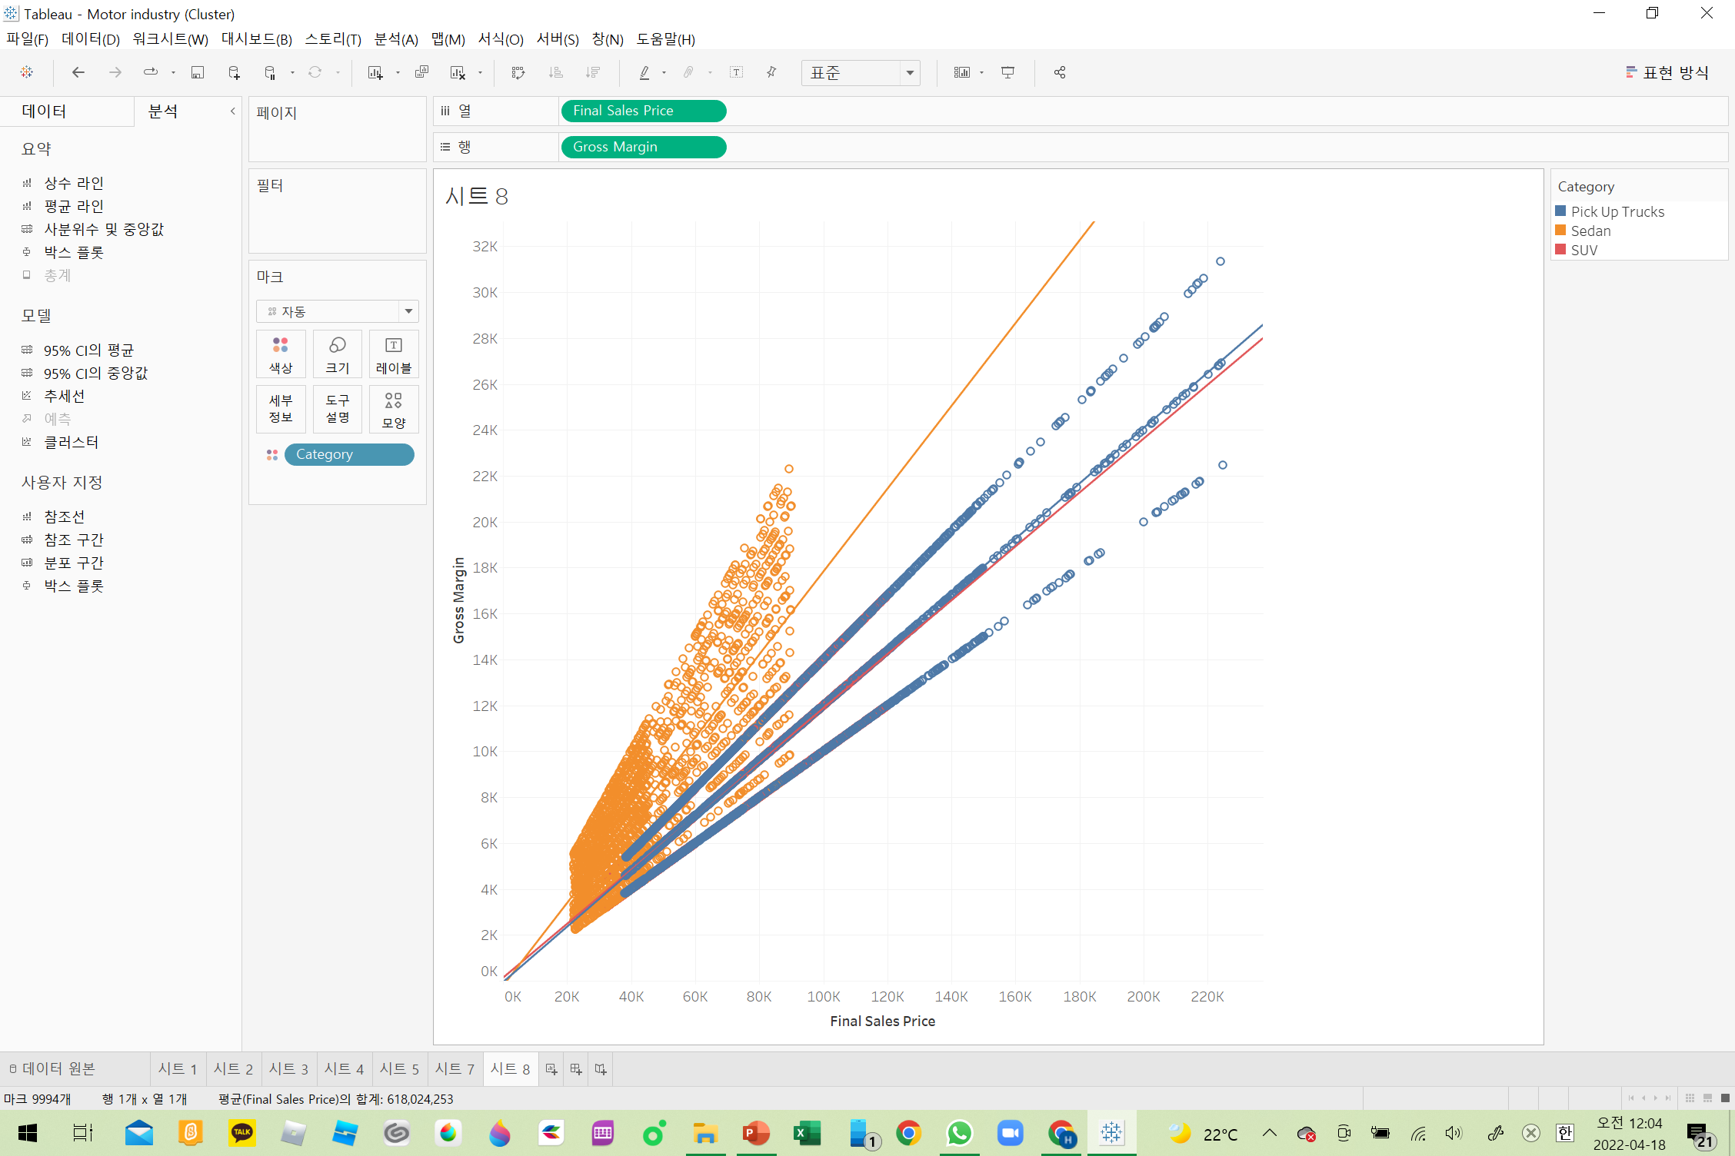





HYPOTHESIS Ⅱ - Sales volume is related with margin
Sales price and margin has positive relationship
The higher sales price, the higher gross margin
Sedan
Pick up
Truck
SUV

Slide 6
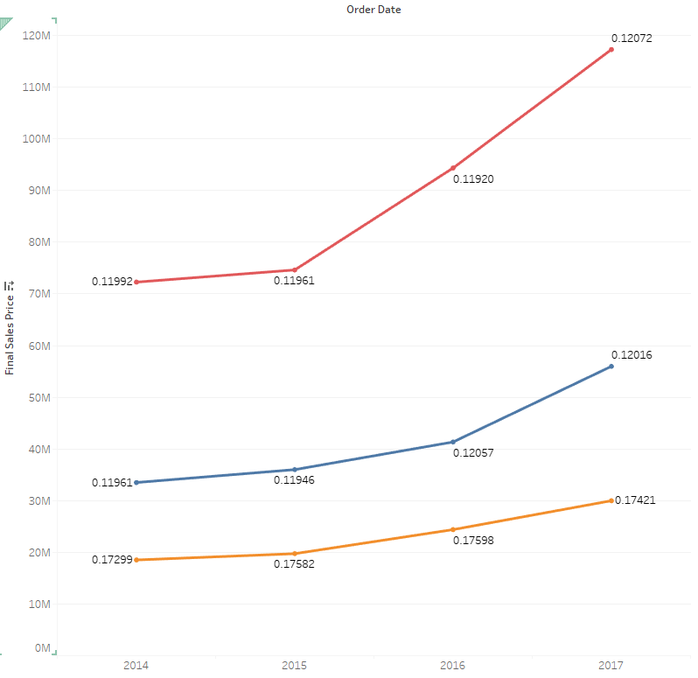
HYPOTHESIS Ⅲ - Based on cultural environment, specific category leads growth
Sales of car is growing annually(2014 ~ 2017)
Among them, growth of SUV sales is higher.
SUV
Pick up
Truck
Sedan

Slide 7
IN THE U.S. MARKET
Hypothesis & Verify
Point of view
Conclusion
Larger cities have more sales
than smaller
Right
In the U.S. market, car sales are increasing, with large margins in populous cities, and consumers prefer to buy SUVs among car models.
Focus on the city with a large population
Find a Similar country to the U.S. auto sales environment.
Sales volume is related
with margin
Right
Based on cultural environment,
specific category leads growth
Right

Slide 8
New Market Selection
What makes Company Success
Rapidly growing Sales - High Sales Competence - Sales Networks across country | Insufficient Global Experience - Different sales at different culture
Increasing interest in Leisure - High demands for SUV Growing market volume in urbanization - Increasing demands in big cities | Fast transformation to EV Several competitors as market growth Increasing demand for used car
① Physically closer countries to reach by company control
③ Avoid sudden challenges against totally new market
S
W
O
T
② Biggest profits come from the Cities with high population density
④ Prepare company transformation for new market trend

Slide 9
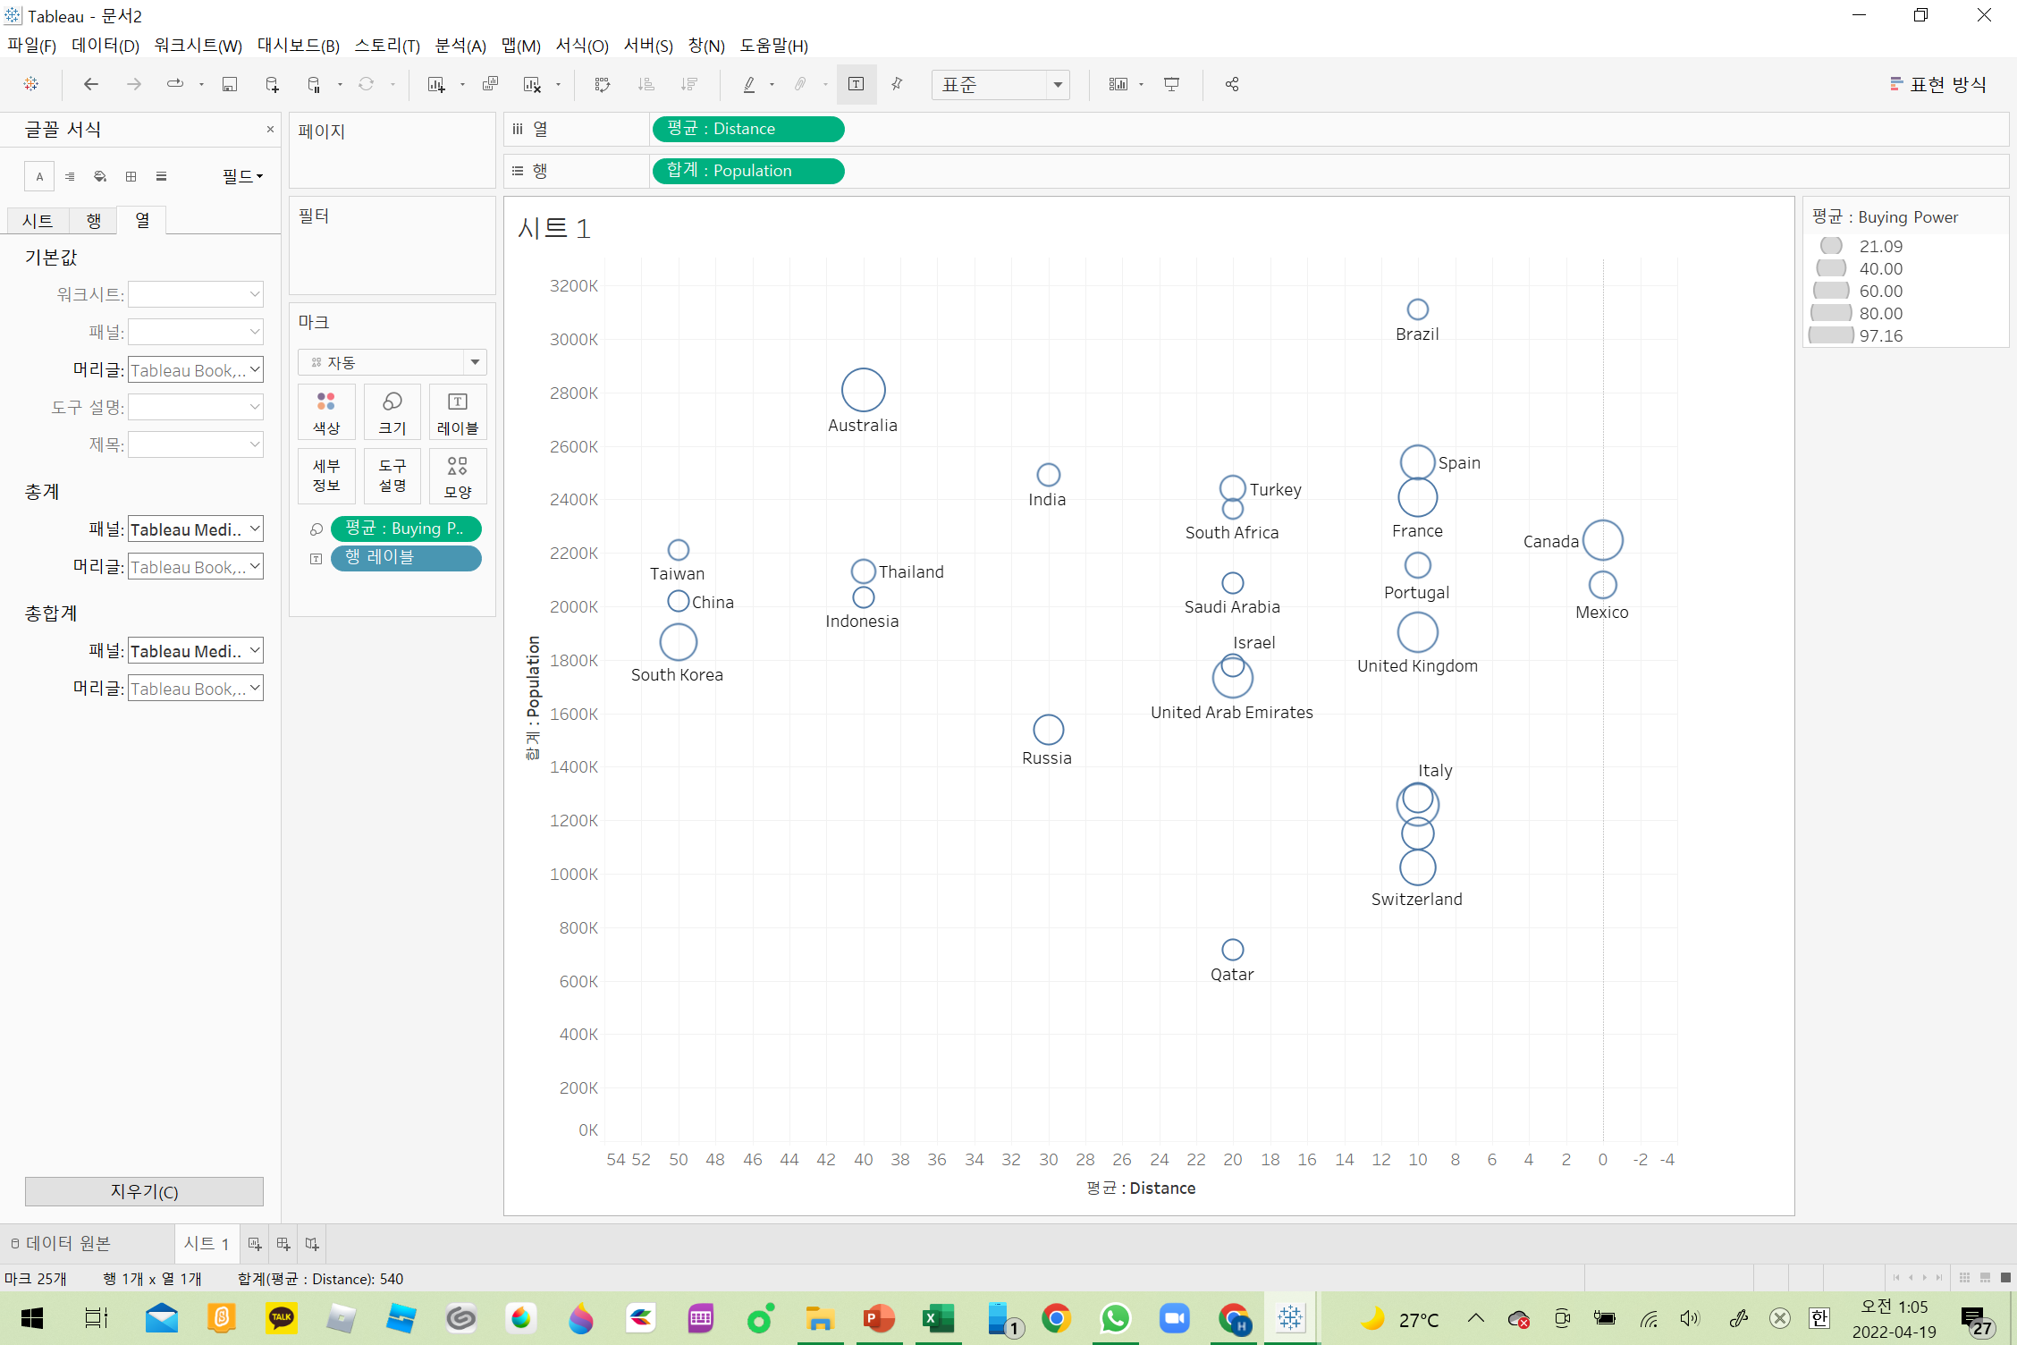
New Market Selection (Continue)
How to choose the Competitive Market
Population
3 aspects to consider
① Physical distance
- The closer geographically, the more similar in cultures
- Able to utilize established company networks and know how
② Population
- List up 1000 cities with high population
- Adapt Average population of big cities instead of total population
③ Purchasing power
- our products are above average in view of price and size
- by filtering lower GDP countries
Target Countries
1.Canada
2.Mexico
3.United Kingdom
* Brazil
France
Spain
Portugal
Distance
* Brazil and Portugal has low purchasing power. Spain and France have different culture (Prefer to small sedan and compact car. 36% compare to 20% SUV, 13% Pick-up)

Slide 10
New Market Strategies
How to Win in the New Market
Expand Coverage with 3 Steps (for ④)
STEP 1
STEP 2
STEP 3
CANADA
MEXICO & U.K.
New Market with New Strategies
Year 0
Year 3
Year 5
Market coverage expansion
By direct control
KEY
DIRECTIONS
Fast growth in new markets
By M&A with existing players
Get into the New Markets with new product and platform
Prepare New products and new sales tools
(by Strategic partnership and digital sales platform)

Slide 11
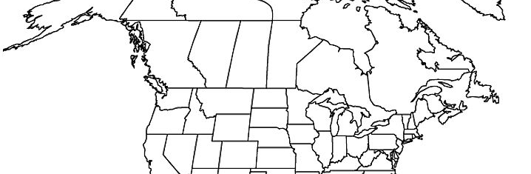
STEP 1 GO CANADA
Direct Approach with Company Strength (with 3C)
CANADA
MEXICO & U.K.
New Market witih New Strateges
Expand Company Capacities to expand coverage
- Simply expand sales networks supported by adjacent branch
- Dispatch key sales managers to each new branch
Direct control 3 new branches in largest cities in Canada
COM
PANY
Break market into 3 section (East, Middle, West)
- Only one large competitor in Vancouver¹⁾
- With aggressive marketing from initial stage
Quebec
Vancourver
Toronto
COM
PETI
TORS
New Coverage
Current Sales Coverage
Company Name | Location | Revenue | Remarks
Jim Patison Group | Vancouver | $29,440m. | Biggest
Auto Canada | Edmonton | $2,542m.
Groupo Volvo Canada | Quebec | $1,383m. | Industrial
Mercedes Benz Canada | Toronto | $784m. | Direct Op.
Key Activities
- Supported by sales networks in close distance
- Dispatch key sales managers to each branch
- Launching promotions in Sep. when begin the biz
Similar Taste with U.S. customers
- No. language or cultural barriers
- SUV 59%, Pick-up 29.7%, Sedan 15.5%²⁾
CUS
TOM
ERS
1) Dun & Bradstreet , 2022 <https://www.dnb.com/business-directory/company-information.automobile_dealers.ca.html>
2) Statista, 2021 <https://www.statista.com/statistics/684218/sales-of-cars-by-segment-in-canada/>

Slide 12
STEP 2 GO MEXICO and United Kingdom
Fast Penetration into market (with PESTEL)
CANADA
MEXICO & U.K.
New Market with New Strateges
Politics
Economy
- Mex : insufficient buying power now, but fast grow
- UK : Considered saturated market
Win high market share in a short time
Challenges
Solution
Mexico
Catch up fast growth
Languages/Culture
Different sales skills
New company required
Social
- Mex : Language and some cultural barriers
- UK : Little demand in Pick-up and high on compacts
Buy existing players
U.K.
Many competitors
Different preferred Segment
Different purchase style
Lower price competitiveness
Technology
- Mex : Many car makers have factories and sell cars directly without dealership
- UK : our main brands (Ford, GM) has little market share
Key Activities
- Evaluate short listed dealers
- Alternatives with repair service or used car sales companies
- understanding different culture is most important, but still hold control not to lose attention on both markets
Environment
- UK : high regulation on Co2 emission
Legal
- Mex : Need to establish separate company (local sales i/o export)
- UK : import duty on 2.5%

Slide 13
STEP 3 Preparation on New Era
Prepare long term growth and sustainability (with 4P)
CANADA
MEXICO & U.K.
New Market with New Strategies
New Products
- Increasing demand of EV
- Most car makers will stop producing Conventional cars shortly
Innovative business transformation is Required
New Products
- Establish Long-term relationship with new technical companies
(New type of car or transportation developer such as drone)
- From beginning stage, financial investment and cooperation needs
Product
New sales
- Tesla has no dealer networks. Only by online sales
Promotion
Price
New sales
- Develop Digital platform (Be amazon in car dealership industry)
- Profits not by personal sales but by intelligence & database
Place
New Markets
- Focus on emerging market specially in China and India
- Prepare new products and sales tools from now on
New Markets
- Fast growing markets (China, SE & ME Asians, India etc.)

Slide 14
THANK YOU
GROUP-2

